Slide 1




Artificial Intelligence for All
Letizia Jaccheri
Inteligência Artificial para Todos
Simpósio Brasileiro de Qualidade de Software (SBQS)

Slide 2

The Distinguished Speakers Program
is made possible by
For additional information, please visit http://dsp.acm.org/

Slide 3
About ACM
ACM, the Association for Computing Machinery (www.acm.org), is the premier global community of computing professionals and students with nearly 100,000 members in more than 170 countries interacting with more than 2 million computing professionals worldwide.
OUR MISSION: We help computing professionals to be their best and most creative. We connect them to their peers, to what the latest developments, and inspire them to advance the profession and make a positive impact on society.
OUR VISION: We see a world where computing helps solve tomorrow’s problems – where we use our knowledge and skills to advance the computing profession and make a positive social impact throughout the world.
I am proud to be an ACM Member.

Slide 4
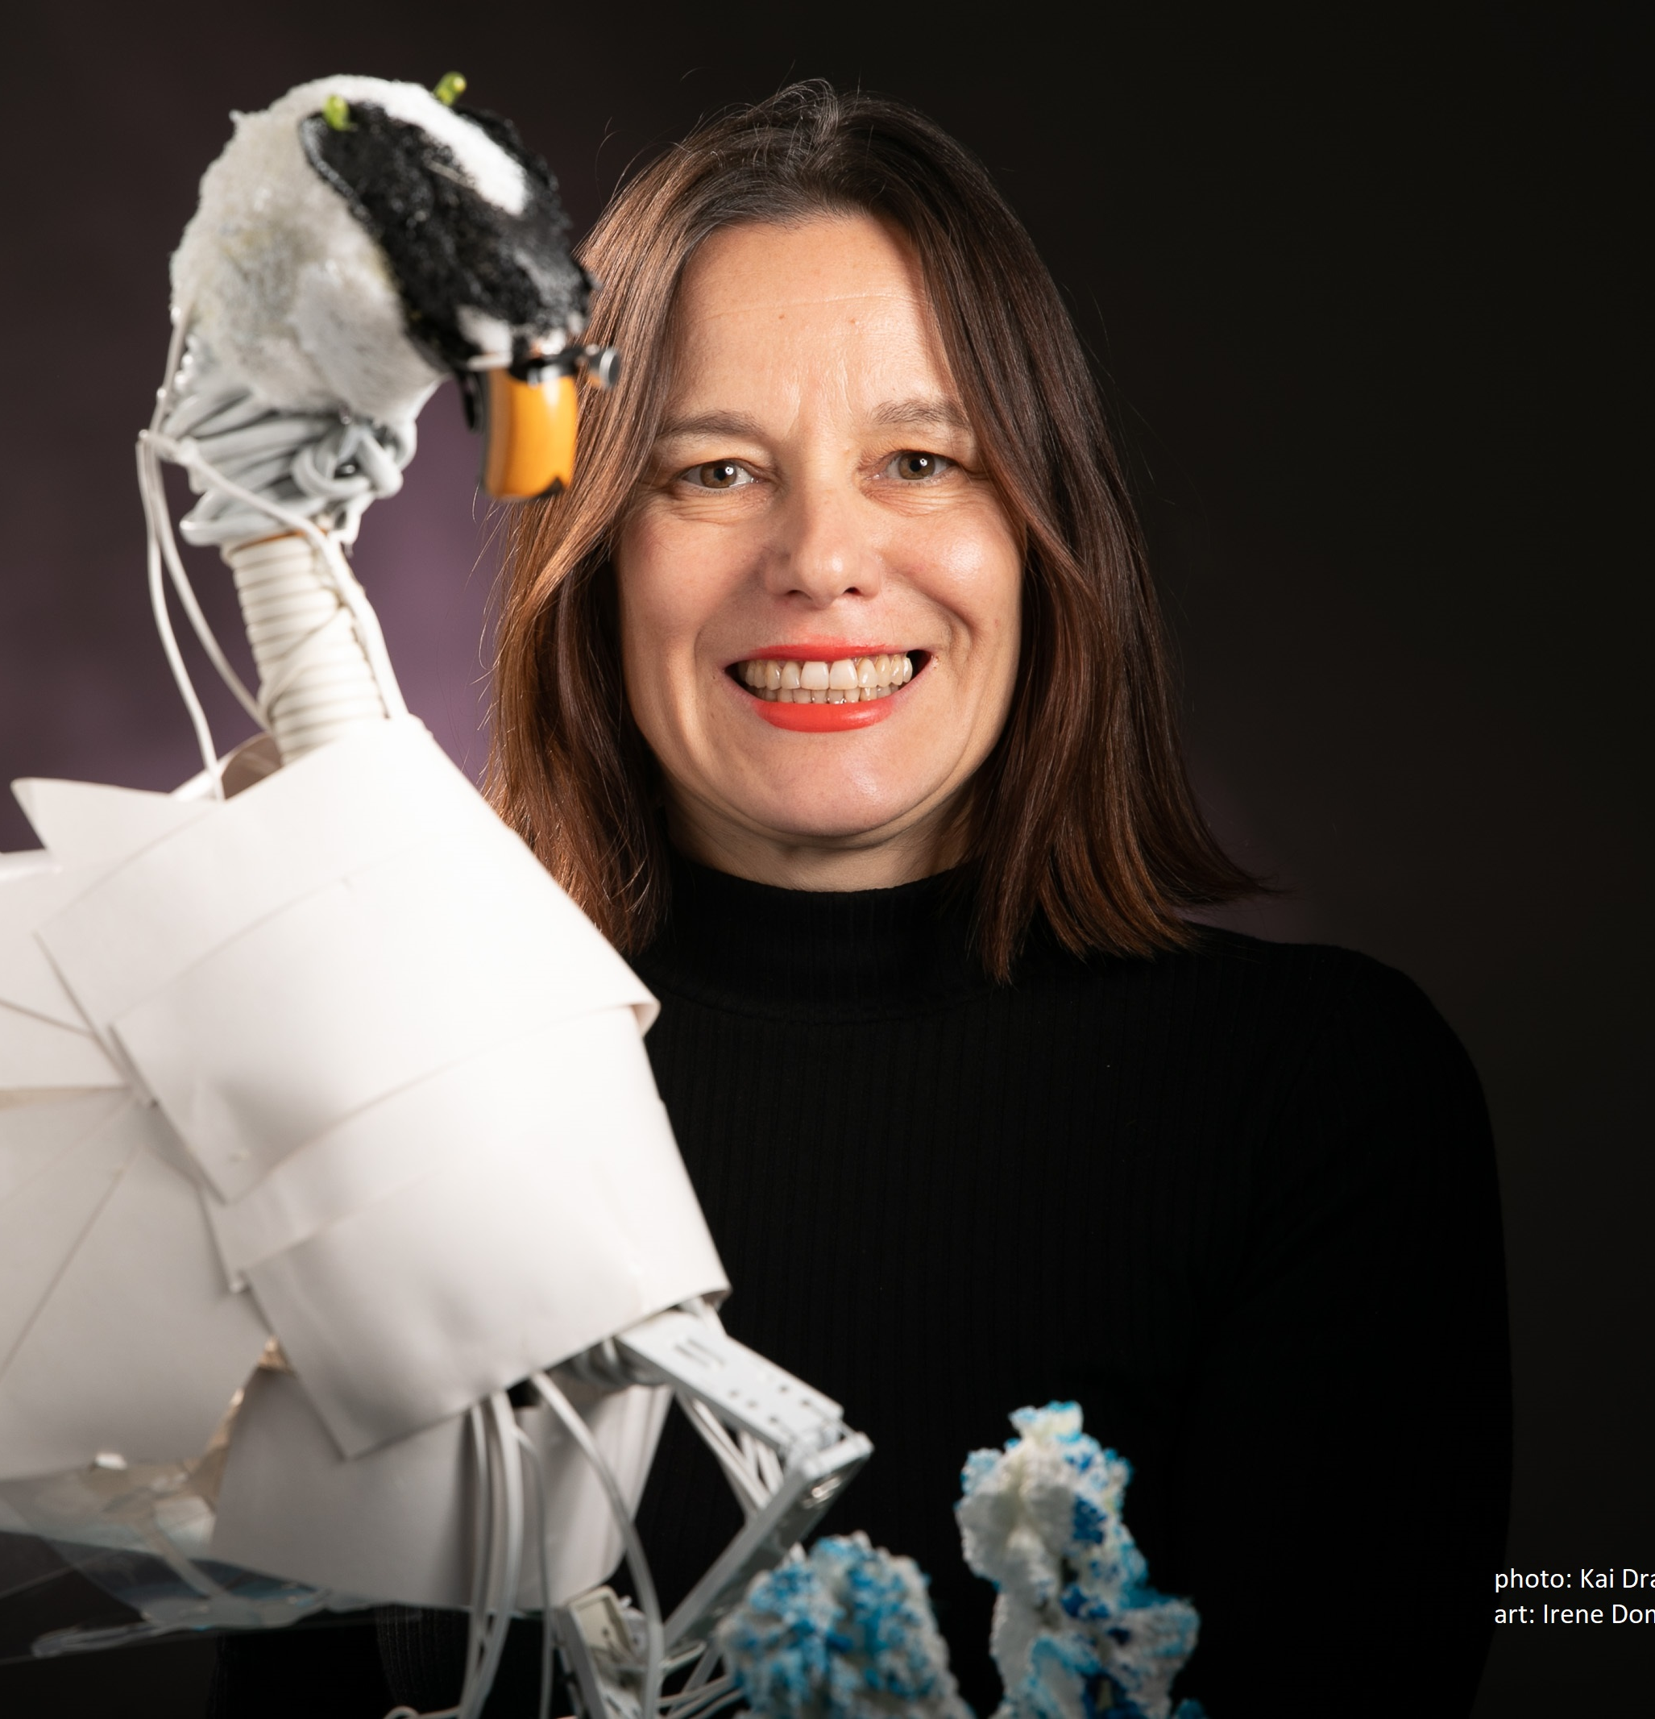
About you
Intervention: An intentional action or program designed to promote gender equality in computer science (software engineering or AI), such as mentoring, workshops, or policy changes.
Research study: A systematic investigation that analyzes data to understand barriers, outcomes, and effective strategies for achieving gender equality in computer science (software engineering or AI).

Slide 5








Norwegian, European, and International best Practices
ADA (1997 – ongoing)
Kodeløypa (2014 – ongoing)
IDUN (2019 – 2022)
EUGAIN (2020 – 2024) Research
SENOBR (2020-2023) Research
Horizon CRAFT (2021 – 2025)
Erasmus+ Women Stem Up (2022 – 2025)
ACM WomENcourage (2023)
Abelia Tech Kvinner (2017 – ongoing)
Erasmus+ TECHLARP (2025 – 2027)
ACM Trondheim Chapter (2020 – ongoing)
AInclusion (2025 – ongoing)
Notes:
But why?
What are the challenges?
And in our projects we are trying to combat these challenges,
Examples from EUGAIN
Calling the applicants, Welcome day, March 8 - Women's Day, Network lunches, Programming courses, social activities such as Mountain hiking, PhD party, Invite high school girls from all over the country, Presentations and workshops, Personal meeting with role models, Break down stereotypes and bias, hire women role models
This is answer to question about what works
Explain briefly what these projects have done and achieved since 1997
Measures such as
Information
Mentoring
Network
Anti bias training

Slide 6

Stakeholders
Status quo
Goal
Type of Intervention
Risks
Plan your own Intervention
Letizia Jaccheri, NTNU
Notes:
Q: Do you know about any interventions/techniques for improving balance and eliminating biases?

Slide 7
Research question
Research method
Data collection
Data analysis
Where to publish
Plan your own Research Study
Letizia Jaccheri, NTNU

Slide 8

https://nettskjema.no/a/565807

Slide 9
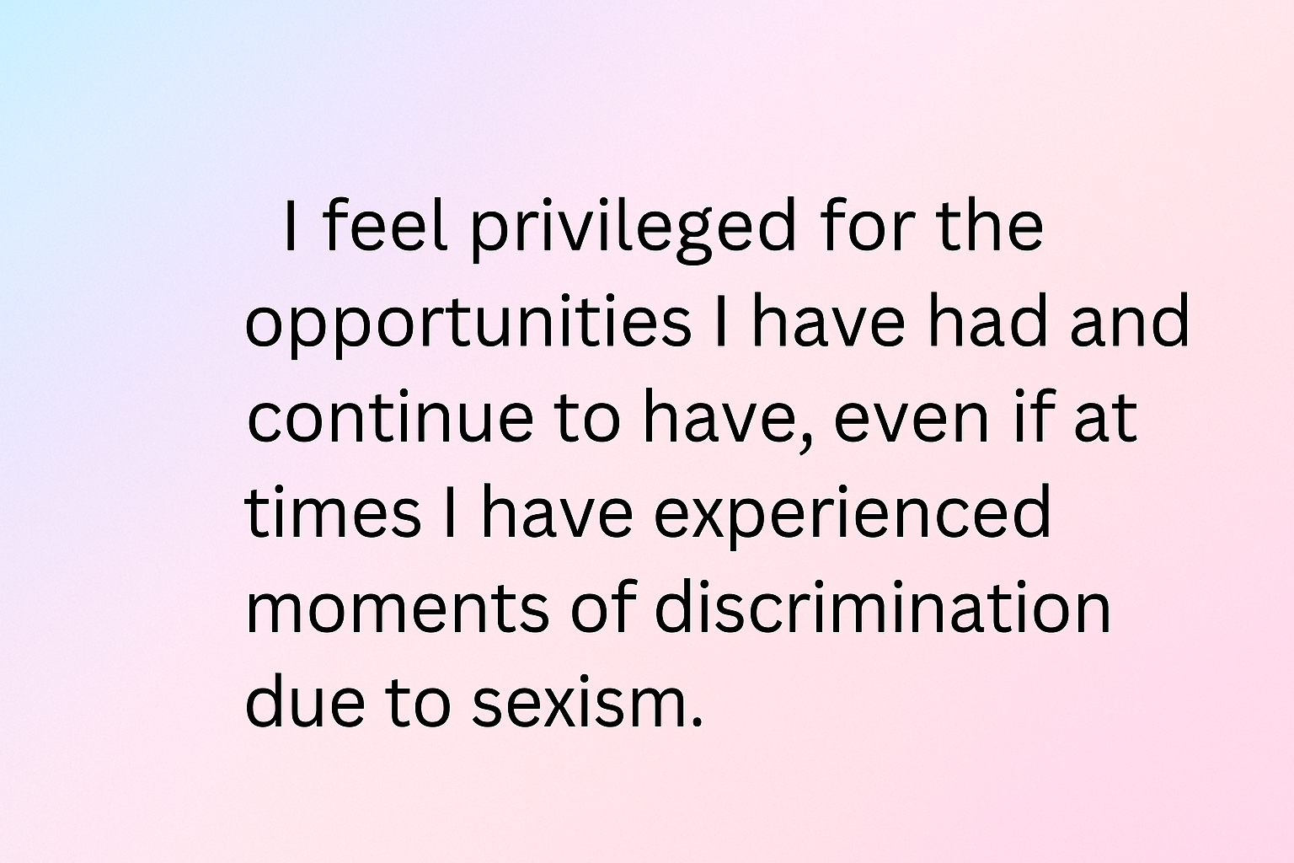
Position

Slide 10
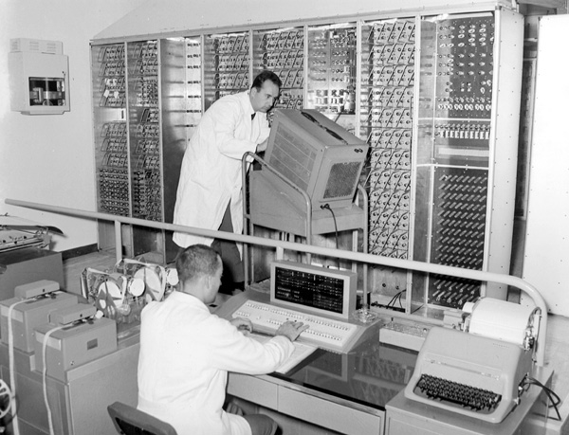
1960
Notes:
It's the 1960s. In Pisa, in November 1961, the large electronic calculator for scientific research developed by the University of Pisa's Research Center was inaugurated at the University of Pisa's Institute of Physics, in the presence of the President of the Republic and the Rectors of all the Italian universities, who had gathered in Pisa for the opening of the new academic year.
The initiative immediately attracted the interest of the Olivetti company of Ivrea, which had already begun electronics studies and designs in connection with its own production programs. Under an agreement with the University of Pisa, Olivetti guaranteed financial support and the collaboration of its specialized personnel.
I, too, was born in the mid-1960s.

Slide 11
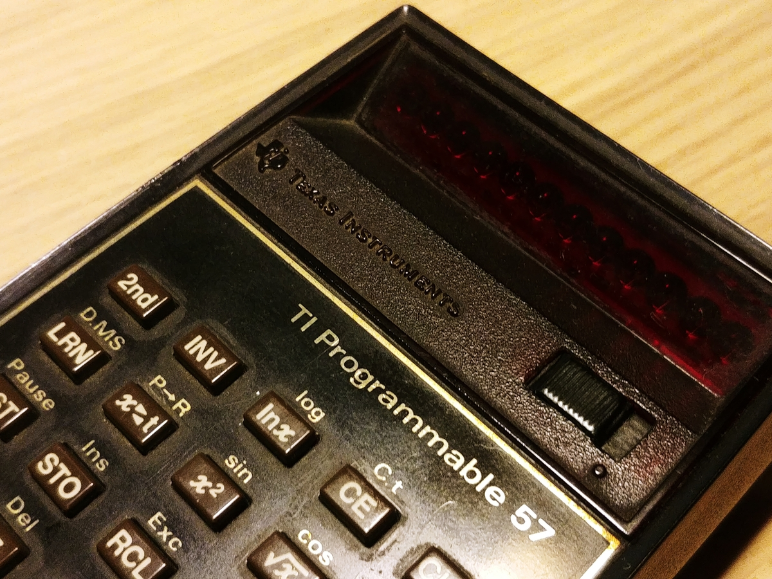
1970
Notes:
In high school, we had two hours of math a week. Our math teacher, Annamaria Bastianoni, taught us how to program the Texas T57 calculator. She had worked as a temporary researcher at the National Research Center when she was young. She was a math teacher at a high school, but she was a pioneer. While the calculator was doing calculations, the teacher would respectfully address the calculator and say, "Think about it."
Math was easy for me, but Greek translations, on the other hand, were becoming increasingly difficult.

Slide 12
1980
Notes:
It is the decade in which I made the most important choices: Computer science, then software engineering and Norway.

Slide 13
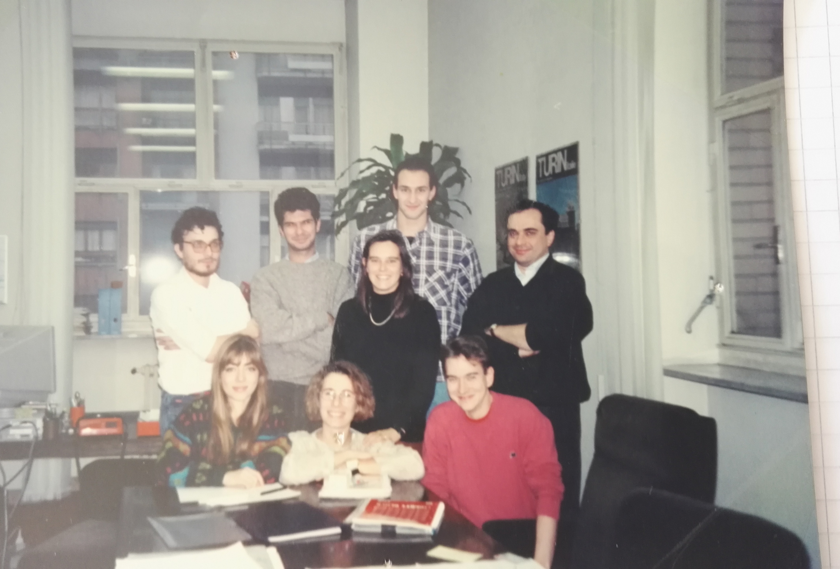
1990
Jaccheri, M. L., & Conradi, R. 1993. Techniques for process model evolution in EPOS. IEEE Transactions on Software Engineering, 19(12), 1145-1156.
Notes:
I came back to Italy and I lived 5 years in Torino. I published my first journal paper with my Norwegian professor Reidar Conradi.

Slide 14

2000
Software engineering issues in interactive installation artA Trifonova, L Jaccheri, K Bergaust International Journal of Arts and Technology 1 (1), 43-65
Notes:
In 2000 I had two children under 2 years, I wrote my book Kjærlighet og Computer and I discovered the world of interdisciplinarity.

Slide 15
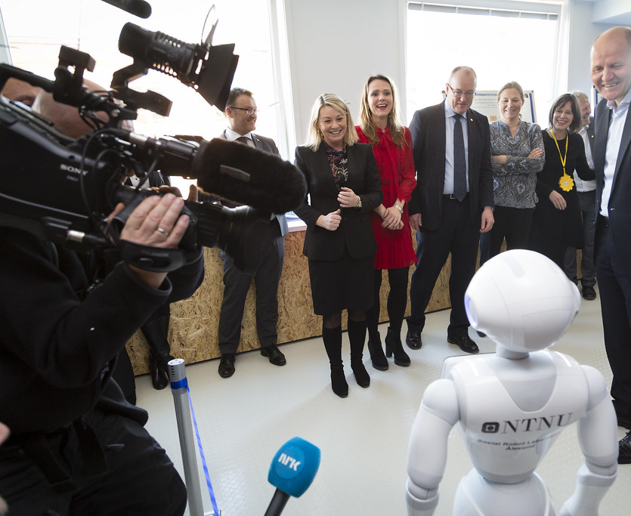
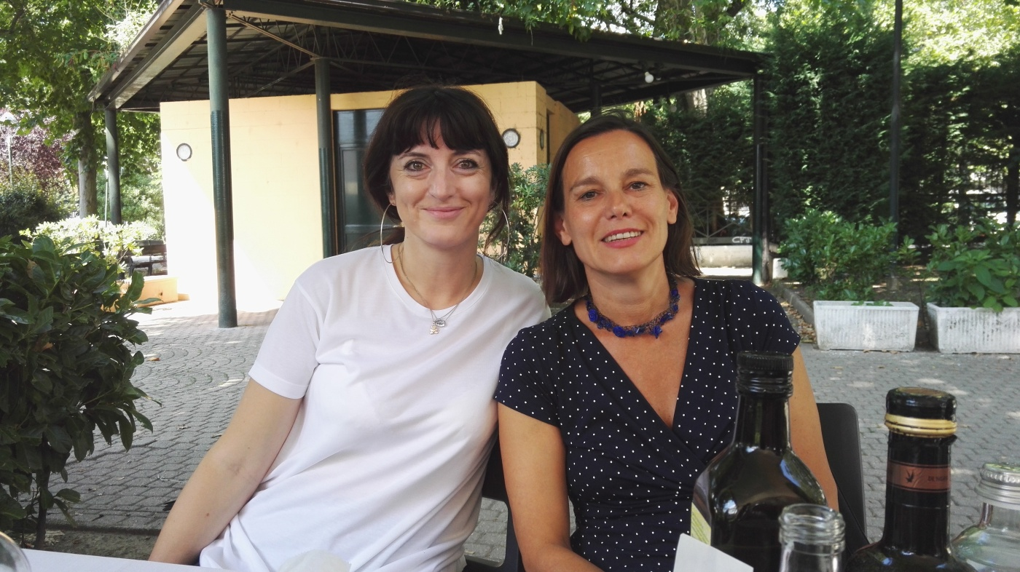
2010
A checklist for integrating student empirical studies with research and teaching goalsJC Carver, L Jaccheri, S Morasca, F Shull Empirical Software Engineering 15 (1), 35-59
Notes:
I became department head. Together with Telenor we started the NTNU AI lab. In this pictures I am together with very important people but I understood that I like to be with students. This paper tells about my struggles on how to combine research and education.

Slide 16
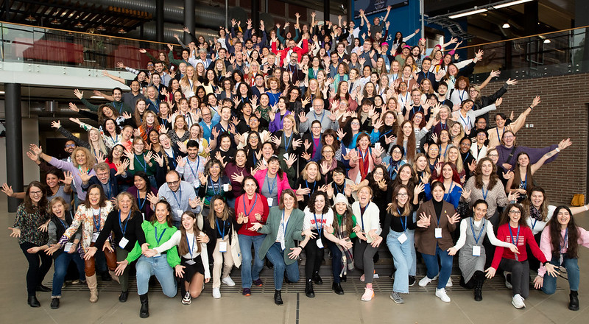
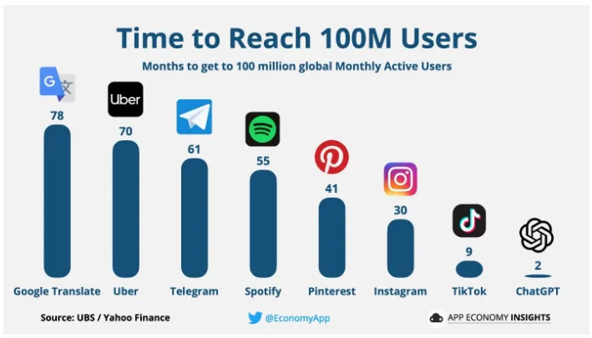
2020
Developing software for motivating individuals with intellectual disabilities to do outdoor physical activity, Juan C. Torrado, Ida Wold, Letizia Jaccheri, Susanna Pelagatti, Stefano Chessa, Javier Gomez, Gunnar Hartvigsen, Henriette MichalsenAuthors Info & Claims, ICSE-SEIS '20: Proceedings of the ACM/IEEE 42nd International Conference on Software Engineering: Software Engineering in Society
Women’s Participation in Student Software Development Teams: A Cross-Sectional Study on Role Distribution, CM Cutrupi, L Jaccheri, S Papavlasopoulou, IEEE Transactions on Software Engineering
Notes:
60 years have passed since the first program in computer science was started in Pisa

Slide 17
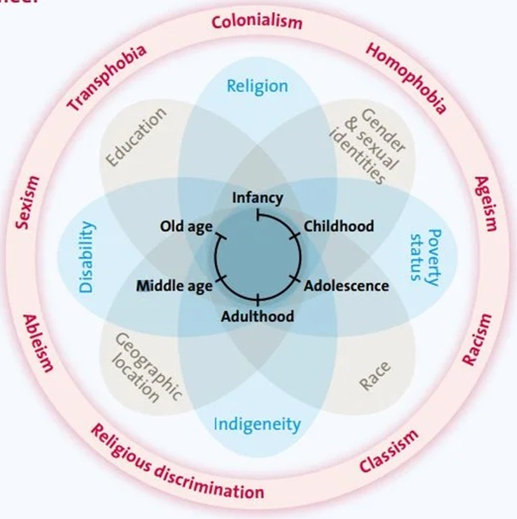
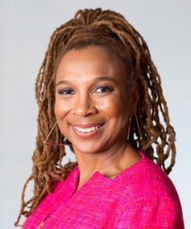
Intersectionality
Bias
Kimberlé Crenshaw 1989
Szlavi, Anna, Marit Fredrikke Hansen, Sandra Helen Husnes, Tayana Uchôa Conte, and Letizia Jaccheri. "Designing for Intersectional Inclusion in Computing." In International Conference on Human-Computer Interaction, pp. 122-142. Cham: Springer Nature Switzerland, 2024.
Takaoka, Alicia Julia Wilson, Claudia Maria Cutrupi, and Letizia Jaccheri. "Intersectional Software Engineering as a Field." Software 4.3 (2025): 18.
Notes:
https://www.unwomen.org/sites/default/files/2022-01/Intersectionality-resource-guide-and-toolkit-en.pdf Intersectionality Resource Guide and Tool Kit
https://youtu.be/akOe5-UsQ2o?si=GSxI73Yif1dw8y7c TEK talk 2 millions play 2016
Intersectionality is an analytical framework used to understand how different social identity categories, such as gender, race, class, sexuality, disability, and more, interact in complex ways and create unique experiences of discrimination or privilege for individuals.
The term was first introduced by American lawyer and academic Kimberlé Crenshaw in the late 1980s. She wanted to explain how black women experienced discrimination in a way that was different from both white women and black men, because they faced both gender and racial discrimination at the same time. Intersectionality therefore looks at how different forms of power and oppression overlap and influence each other.
For example, a black, disabled, lesbian woman may experience discrimination based on all of these identity aspects at the same time, giving her a different experience than someone who only experiences discrimination based on one of these identity categories.
Intersectionality is important for understanding that social problems and injustice cannot be solved by looking at each identity category in isolation. It requires a holistic approach that takes into account the different layers of identity and how they influence each oth

Slide 18
Software Engineering
Gender
Analysis and Design | Empirical software engineering | Software quality | Architecture | Processes | AI and SE | Human factors in SE
Gender and sex | Non-binary | LGBT+ rights | #metoo 2017 | Same-sex marriage 2001 | Intersectionality – triply | feminism
Notes:
Quality of the process and quality of the software
How do we understand gender and SE?
gender as a social construction (as opposed to sex, which is by birth) (it: genere, sesso – no:
gender as a non-binary term (as opposed to what it used to be: binary male vs female) - recent steps (correlated)
in the women's rights movement #metoo started in 2017
as well as the LGBTQ rights movement, while the first gay movement started more than 100 years ago, The Netherlands was the first country to allow same-sex marriage in 2001.
defining one's pronouns has become trendy (she/her)
non-binary acceptance of gender
intersectionality, that is, that our identities have several layers and they influence one another --> people who are not only women, but also LGBTQ and of color, are triply underprivileged and left out of rights not only in everyday life but in digital services as well.
gender equality charts in the EU or over the world and Gender Gap Index
education + social stereotypes --> girls' barriers to get into IT and CS
due to women's lack, and the lack of diversity, in IT teams --> bias in designing products due to a lack of diversity, for ex. HCI, AI, etc.
this creates usability problems, tech issues, discrimination, the spread of bias, etc. It is crucial to underline that taking gender into account in tech is not only a human rights issue, but an economic and technological need.

Slide 19

Women in ICT
2012: 17%
2023: 19,4%
Which are the numbers for your stakeholder group?
Notes:
Some numbers about ICT specialists in Europe and World and who are the ICT specialists
In 2022, 9.4 million people in the EU worked as ICT specialists
In the world 55.3 million in 2020
3 out of 4 companies have problems finding specialists with the right skills
And how many ICT specialists are women?
2% in 10 years
How many years will it take if we continue like this?
eurostat
https://ec.europa.eu/eurostat/statistics-explained/index.php?title=ICT_specialists_in_employment
In 2023, 80.6 % of men were employed as ICT specialists in the EU against 19.4 % of women.

Slide 20
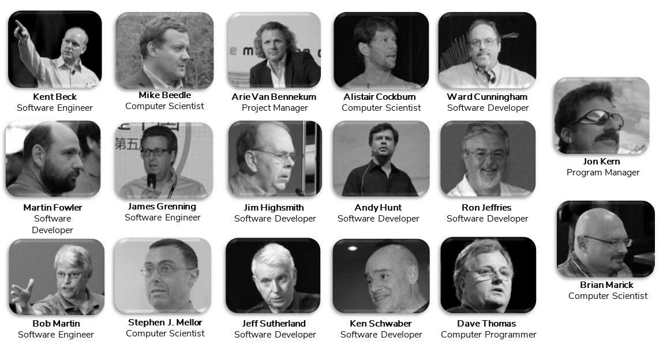
17 MEN CREATED
THE AGILE MANIFESTO
Notes:
Who developed the agile manifesto?

Slide 21
Why?
Stereotypes
Insufficient Knowledge of jobs
Job adv oriented towards men
Social expectations
Notes:
But why?
What are the challenges?
And in our projects we are trying to combat these challenges,

Slide 22
Interventions
Information
Network
Anti bias training
Mentoring
Notes:
Examples from ADA
Calling the applicants, Welcome day, March 8 - Women's Day, Network lunches, Programming courses, social activities such as Mountain hiking, PhD party, Invite high school girls from all over the country, Presentations and workshops, Personal meeting with role models, Break down stereotypes and bias, hire women role models
This is answer to question about what works
Explain briefly what these projects have done and achieved since 1997
Measures such as
https://www.ntnu.no/ada
https://www.ntnu.edu/idun
Eugain.eu
https://www.ntnu.edu/smartcities/craft
https://liu.se/en/news-item/erasmus-projektet-women-stem-up-tilldelas-4-1-miljoner-kronor
https://womencourage.acm.org/2023/
https://www.abelia.no/50techkvinner/

Slide 23



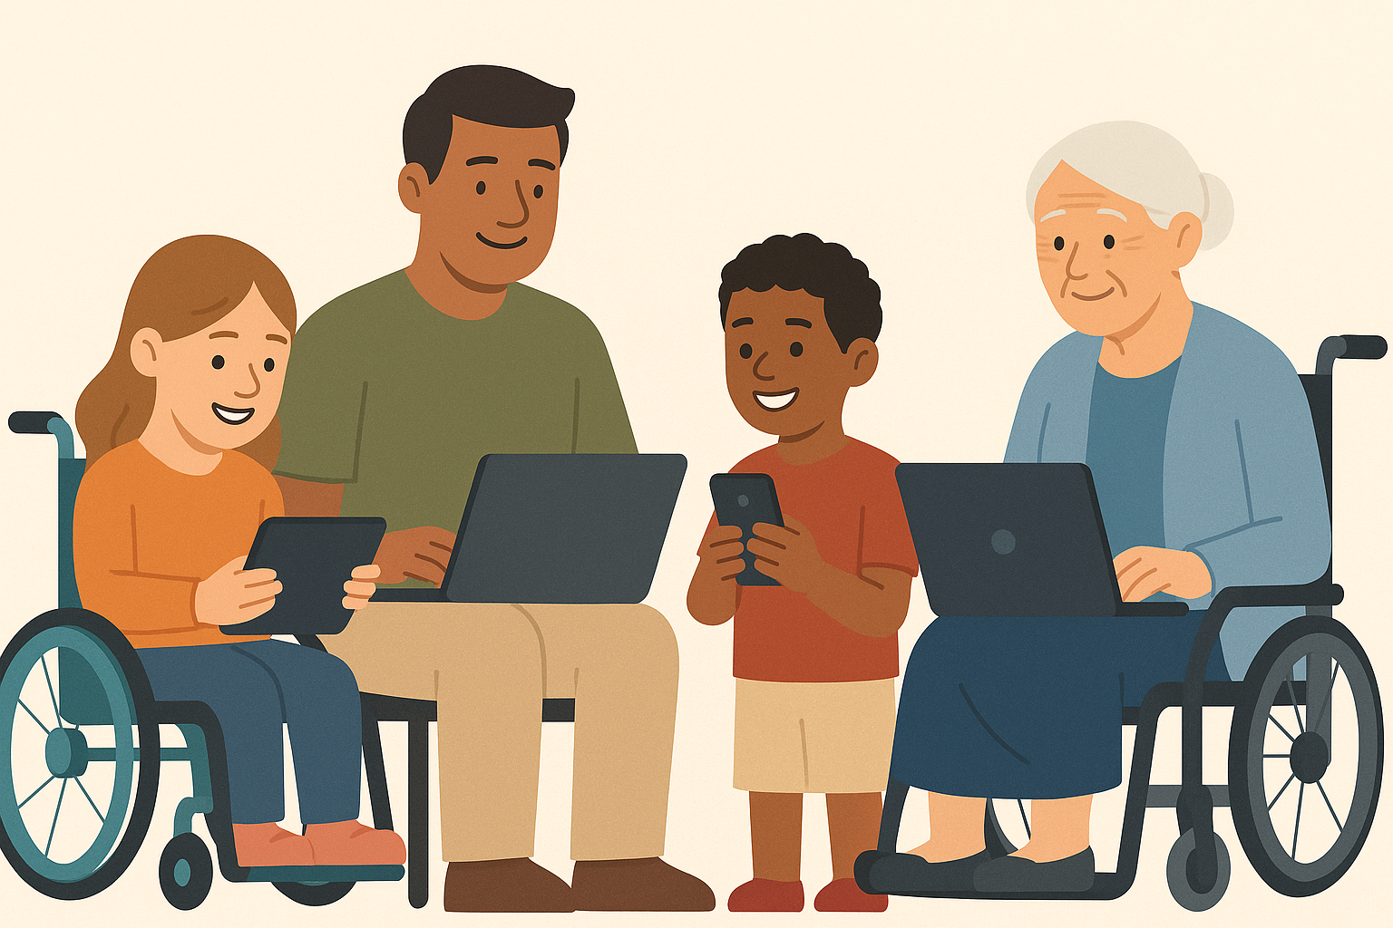
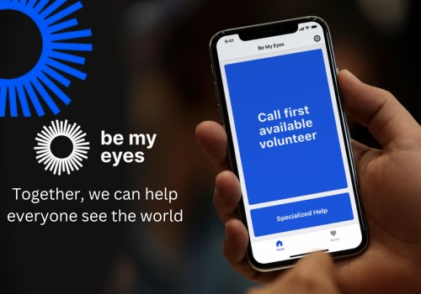

Software Engineering for all

Slide 24

Software Engineering with AI for all
Notes:
CS started in early 60’s. the subfields are inter-related and discoveries and innovations in one field can bring challenges, discoveries and innovations in other field. My own field software engineering is very inter related with AI as we use AI tools to develop software AND we use software engineering techniques and processes to develop AI systems.

Slide 25







10 apps for people with disabilities
Be My Eyes (blind)
VoiceOver (blind)
Wheelmap (wchair)
Avaz Pro (non verbal)
SoundAlert (hearing
Aira (low vision)
Proloquo2Go (speech)
TapToTalk (language autism)
Medisafe (medication)
Dragon Anywhere (hand-free)
Notes:
https://medium.com/@rana.adnanali/top-10-mobile-apps-that-make-life-easier-for-people-with-disabilities-681a5fedf3ef
1. Be My Eyes
Connecting visually impaired users with volunteers through video calls, this app provides real-time assistance for tasks that require sight, such as identifying objects or reading labels.
2. VoiceOver
Apple’s built-in screen reader enhances device accessibility for blind and visually impaired users by narrating what’s on the screen, enabling independent device usage.
3. Wheelmap
Promoting inclusivity, this app crowd-sources information about wheelchair-accessible places, allowing users to navigate urban environments confidently.
4. Avaz Pro
Catering to non-verbal individuals, this communication app employs customizable picture-based communication to foster expression and connection.
5. SoundAlert
Enhancing safety for users with hearing impairments, this app alerts them to important sounds in their environment, providing awareness and security.
6. Aira
By combining wearable technology and human agents, Aira assists blind and low-vision users with navigation, reading, and other daily tasks.
7. Proloquo2Go
This symbol-based communication app aids those with speech and language difficulties, enabling effective expression and communication.
8. TapToTalk
Focusing on language development and communication for users with autism, this app employs picture-based communication to foster interaction and learning.
9. Medisafe
Managing medication schedules is made easier with this app, particularly for users with cognitive impairments, promoting adherence and well-being.
10. Dragon Anywhere
Providing a hands-free control option for those with mobility impairments, this dictation app enables users to navigate mobile devices without physical input.

Slide 26

AI – Women
Female roles in AI
Siri voice
Avatar
AI for/against women
For – Menstruation Apps, Designing Software to Prevent Child Marriage Globally, Tappetina
Against - automatic processing of CVs
Women creating AI
Fei Fei Li
Francesca Rossi
Kodiyan, A. A. (2019). An overview of ethical issues in using AI systems in hiring with a case study of Amazon’s AI based hiring tool. Researchgate Preprint, 12(1), 1-9.
Notes:
Kvinner er et eksempel
The Top 10 women in the world of AI in 2023 https://aimagazine.com/top10/the-top-10-women-in-the-world-of-ai-in-2023
Paper https://dl.acm.org/doi/abs/10.1145/3311927.3325322

Slide 27
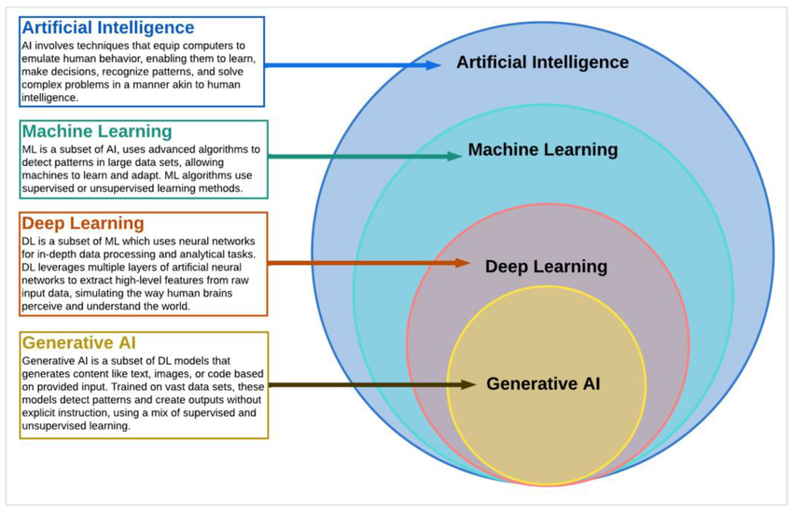
AI Definitions
AI is a field of study (and research field) within computer science that develops and studies intelligent machines
AI stands for a computer system that performs tasks that typically require human intelligence, such as recognizing speech, making decisions and identifying patterns
Generatively create new content (sound, code, images, text, video)
Notes:
AI has become a catchall term for applications that perform complex tasks that once required human input, such as communicating with customers online or playing chess. The term is often used interchangeably with its subfields, which include machine learning (ML) and deep learning.
There are differences, however. For example, machine learning is focused on building systems that learn or improve their performance based on the data they consume. It’s important to note that although all machine learning is AI, not all AI is machine learning.
To get the full value from AI, many companies are making significant investments in data science teams. Data science combines statistics, computer science, and business knowledge to extract value from various data sources.

Slide 28
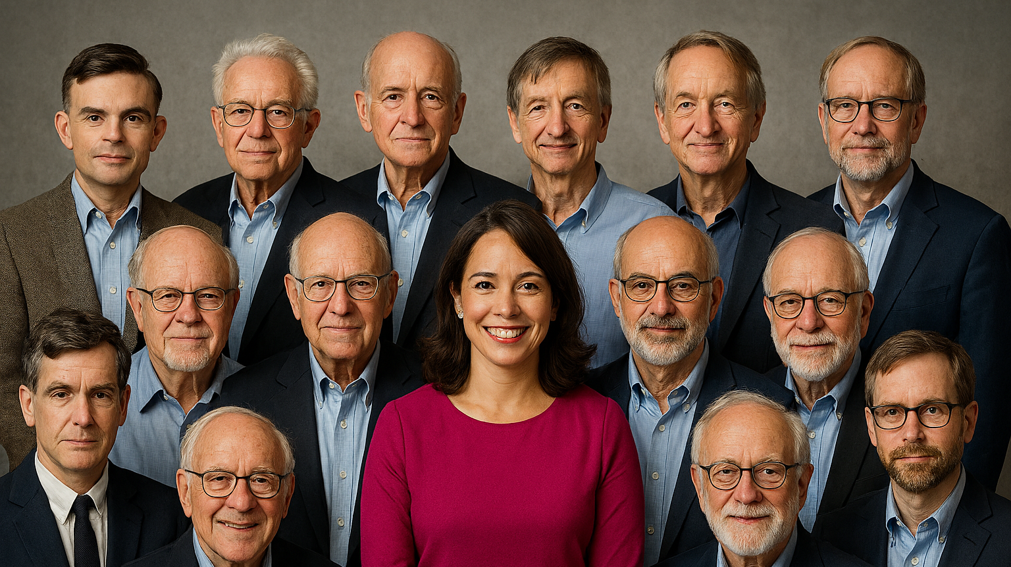

Slide 29
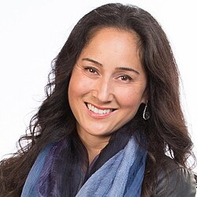
AI
1950 Alan Turing “Computer Machinery and Intelligence”
1956 John McCarthy - academic discipline and first AI programs (LISP)
1959 Arthur Samuel created the term machine learning
1965 Edward Feigenbaum and Joshua Lederberg first expert system
1966 Joseph Weizenbaum first chatbot ELIZA
1968 Alexey Ivakhnenko Deep Learning
1980 Geoffrey Hinton Neural networks
1997 Deep Blue (developed by IBM) beat Gary Kasparov
2000 Cynthia Breazeal developed the first robot that could simulate human emotions
2006 Companies such as Twitter, Facebook, and Netflix started utilizing AI as a part of their advertising and user experience (UX) algorithms
2011 Apple released Siri, the first popular virtual assistant.
2022 (30 November) Open AI CHATGPT available
2024
  Nobel Prize in Physics John J. Hopfield and Geoffrey E. Hinton - enable machine learning with artificial neural networks.
  Nobel Prize in Chemistry David Baker, Demis Hassabis, and John M. Jumper for developing AI algorithms that solved the 50-year protein structure prediction challenge
Notes:
https://dorik.com/blog/history-of-ai
The 1956 Dartmouth workshop was the moment that AI gained its name
URL
The history of AI
1950s: The first AI programs were written to run on the Ferranti Mark 1 machine of the University of Manchester: a checkers-playing program written by Christopher Strachey and a chess-playing program written by Dietrich Prinz.
1960s: The Dartmouth Conference was organized by John McCarthy, Marvin Minsky, Nathaniel Rochester, and Claude Shannon to discuss the possibility of thinking machines and artificial intelligence.
1970s: The first expert systems were developed.
1980s: The first neural networks were developed.
1990s: The first autonomous robots were developed.
2000s: The first self-driving cars were developed.google translator came in 2006 based on statistical methods.
2010s: The first AI-powered virtual assistants were developed. Deep learning revolution, AlexNet 2012
2020s: AI continues to advance and is being used in a wide range of applications, from healthcare to finance to transportation 1.

Slide 30
Why now?
Hardware – software – data
GPT – Generativ Pretrained Transformer autumn 2022

Slide 31
Hardware
From Kilobyte til Petabyte 10¹⁵
Notes:
It is a big misconception that you need to be very intelligent and preferably a man to understand computers, algorithms and AI. I have been working with data since the early 80s, it was kind of by chance. And I think it is as difficult to figure out a knitting pattern as it is to understand algorithms.
We need the past to have a language to talk about the present and the past
K = 1000
Giga = 1000000000
104 = 10000
1017 = 100,000,000,000,000,000
Memory 36 Kbyte
Speed ​​104 flops
Floating point operation per second
– now 8 Giga
– now 1017

Slide 32
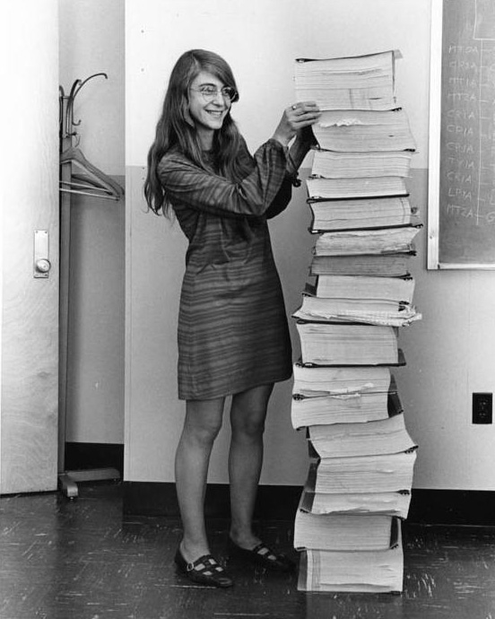
Software
Margaret Hamilton (1936)
Apollo 145,000 lines of code
Now millions of lines of code
Notes:
Margaret Hamilton (who I met once!), the first person to coin the term software engineering and who wrote the software for the Apollo expedition in the 60s is a woman (Apollo first man on the moon)
Margaret Hamilton (who I met once!), the first person to coin the term software engineering and who wrote the software for the Apollo expedition in the 60s is a woman
Apollo 145,000 lines of code
Now millions of lines of code

Slide 33

Data
CHAT GPT 4 has been trained on almost all text ever written
10¹³
GPT-3 has an estimated training time of 355-GPU-years and an estimated training cost of $4.6 million.
- If we trained GPT-3 on IDUN, it would take 355/36 = 10 years
Notes:
According to https://www.youtube.com/watch?v=_6R7Ym6Vy_I&t=2220s
All human written text = 10¹³
CHAT GPT 4 = 300 x 10¹²

Slide 34
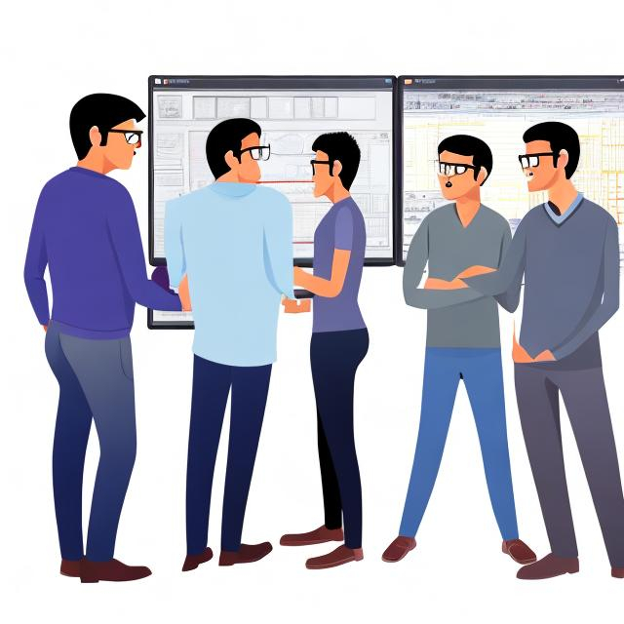
I asked OpenArt
During Autumn 2023, I asked OpenArt to draw four software engineers

Slide 35

I asked again in 2025

Slide 36
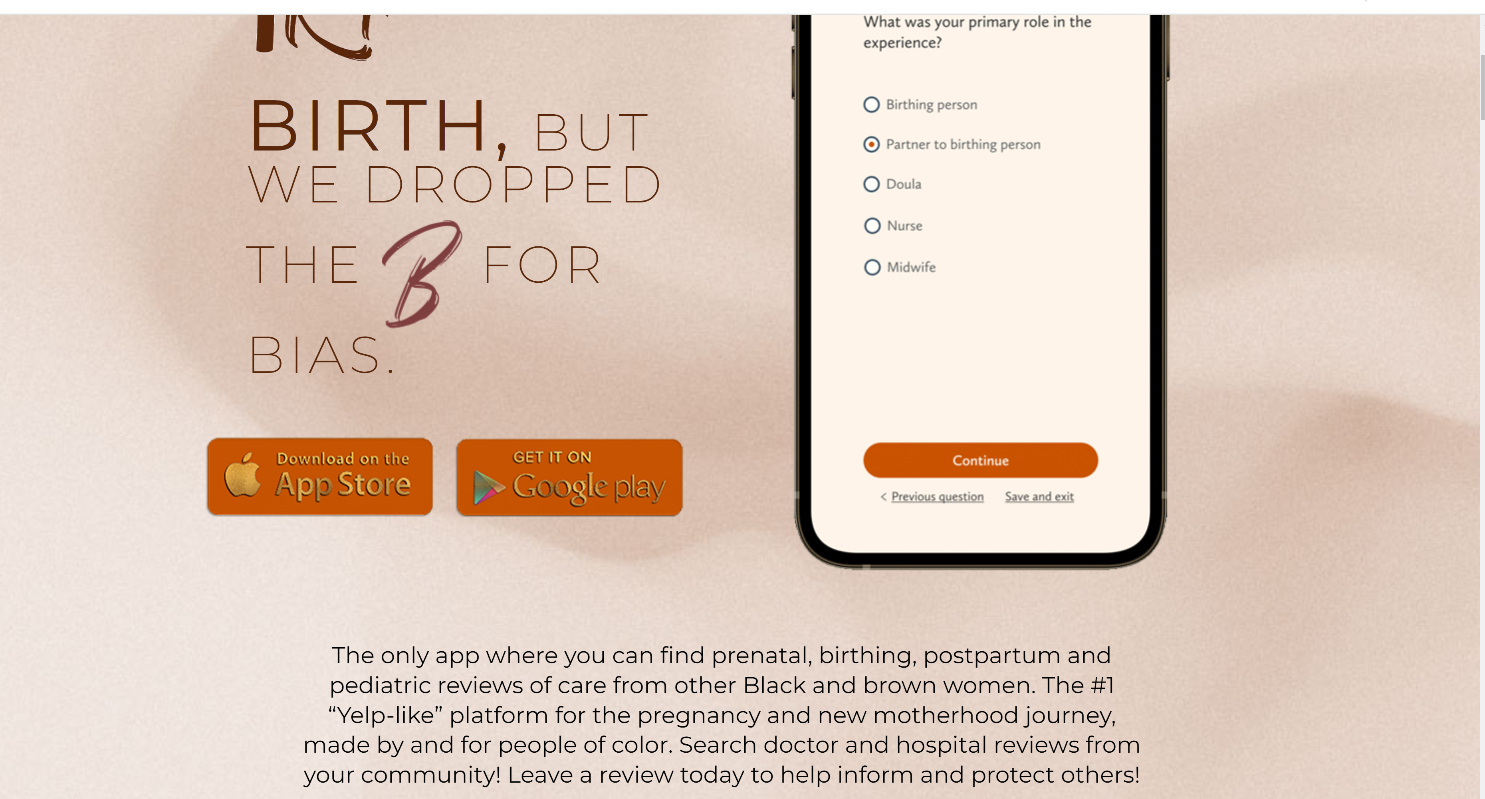
AI for all
We cannot change old networks, we can make new ones around AI
AI for women https://irthapp.com/
EmpowHerAI
AI for your stakeholder group?
Ainclusion

Slide 37
AI ACT
While the Act does not explicitly mention individuals with disabilities, it emphasizes the importance of ensuring that AI systems are accessible and do not discriminate against any group.
Notes:
Risiko nivå
Vi har allerede regler som regulerer diskriminering i Norge og i Europa

Slide 38

What is the EU AI Act?
World’s first comprehensive AI law (adopted July 2024, effective August 2024).
Goal: Ensure AI is safe, transparent, non-discriminatory, and human-centric.
Risk-based approach:
  Unacceptable risk: Prohibited (e.g., social scoring, manipulative AI).
  High risk: Strict compliance (e.g., recruitment, credit scoring, medical diagnosis).
  Limited risk: Transparency obligations (e.g., chatbots, deepfakes).
  Minimal risk: No regulation (e.g., spam filters, games).
  General-Purpose AI: Transparency, copyright compliance, risk mitigation.
  Penalties: Up to €35M or 7% of global turnover.
  Timeline: Full obligations for high-risk systems by August 2027.

Slide 39
Inclusivity and AI for All
Human-Centric Design: Respect fundamental rights, avoid discrimination.
AI Literacy: Organizations must train staff on AI risks and benefits (since Feb 2025).
Accessibility & Fairness: Ban exploitation of vulnerabilities (age, disability, socio-economic status).
Transparency for Users: People must know when interacting with AI or AI-generated content.
Support for SMEs & Startups: EU programs promote inclusive innovation aligned with EU values.
Global Reach: Applies to any AI system impacting EU citizens, ensuring fairness beyond borders.

Slide 40
How to set up an intervention

Slide 41
What do we want?
Equal rights
Diversity of thoughts
Economic reasons

Slide 42
The European Commission report Women active in the ICT sector concludes that including more women in the digital economy could create an annual GDP boost in the EU of EUR 9 billion.
Notes:
https://www.itu.int/en/ITU-D/Digital-Inclusion/Women-and-Girls/Girls-in-ICT-Portal/Documents/women_active_in_ict.pdf

Slide 43

curb cut
Notes:
The Curb-Cut Effect is a vibrant illustration of how laws and programs designed to benefit vulnerable groups, such as the disabled or people of color, often end up benefiting all.

Slide 44
Women in ICT
2012: 17%
2023: 19,4%
Which are the numbers for your stakeholder group?
Notes:
Some numbers about ICT specialists in Europe and World and who are the ICT specialists
In 2022, 9.4 million people in the EU worked as ICT specialists
In the world 55.3 million in 2020
3 out of 4 companies have problems finding specialists with the right skills
And how many ICT specialists are women?
2% in 10 years
How many years will it take if we continue like this?
eurostat
https://ec.europa.eu/eurostat/statistics-explained/index.php?title=ICT_specialists_in_employment
In 2023, 80.6 % of men were employed as ICT specialists in the EU against 19.4 % of women.

Slide 45

Female ICT students in 2021
20%
29%
Notes:
Numbers for bachelor master phd – in Norway we are doing a bit better 29%

Slide 46
Feminism is a movement advocating for women's rights and gender equality and it is a field of study. It began in the late 18th century calling for women's education and equal rights.
in the 19th and early 20th centuries, focused on legal issues like suffrage, culminating in women gaining the right to vote in many countries Norway 1913 – Italy 1945 - Switzerland 1971 (1991) - Afghanistan under Taliban control – Tuscany ++
from the 1960s to the 1980s, addressed broader social issues like reproductive rights, workplace discrimination, and sexuality.
The third wave, starting in the 1990s, challenged gender norms and embraced diversity, addressing issues of race, class, and LGBTQ+ rights.
Today, feminism continues to evolve, focusing on intersectionality and global gender inequalities.
Notes:
during the Enlightenment, with thinkers like Mary Wollstonecraft

Slide 47

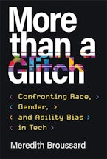
(some) biases in Computing/AI
Cultural/Social bias: These biases are often unconscious and can lead to discrimination, unfair treatment, and exclusion of certain groups in areas like hiring, healthcare, and legal proceedings.

Slide 48
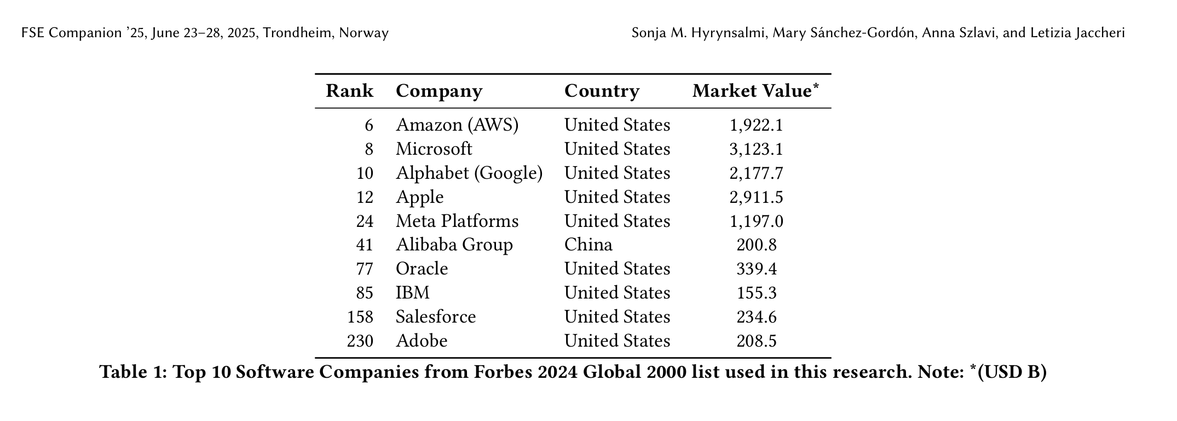
Corporate defunding DEI programs
Big tech companies are rethinking their strategy, either by reducing, increasing, or renaming their DEI initiatives.
Some companies keep on with their DEI strategy, at least so far, despite the challenging political climate.
Hyrynsalmi, Sonja, et al. "The Tech DEI Backlash-The Changing Landscape of Diversity, Equity, and Inclusion in Software Engineering." Proceedings of the 33rd ACM International Conference on the Foundations of Software Engineering. 2025. https://dl.acm.org/doi/abs/10.1145/3696630.3728695

Slide 49
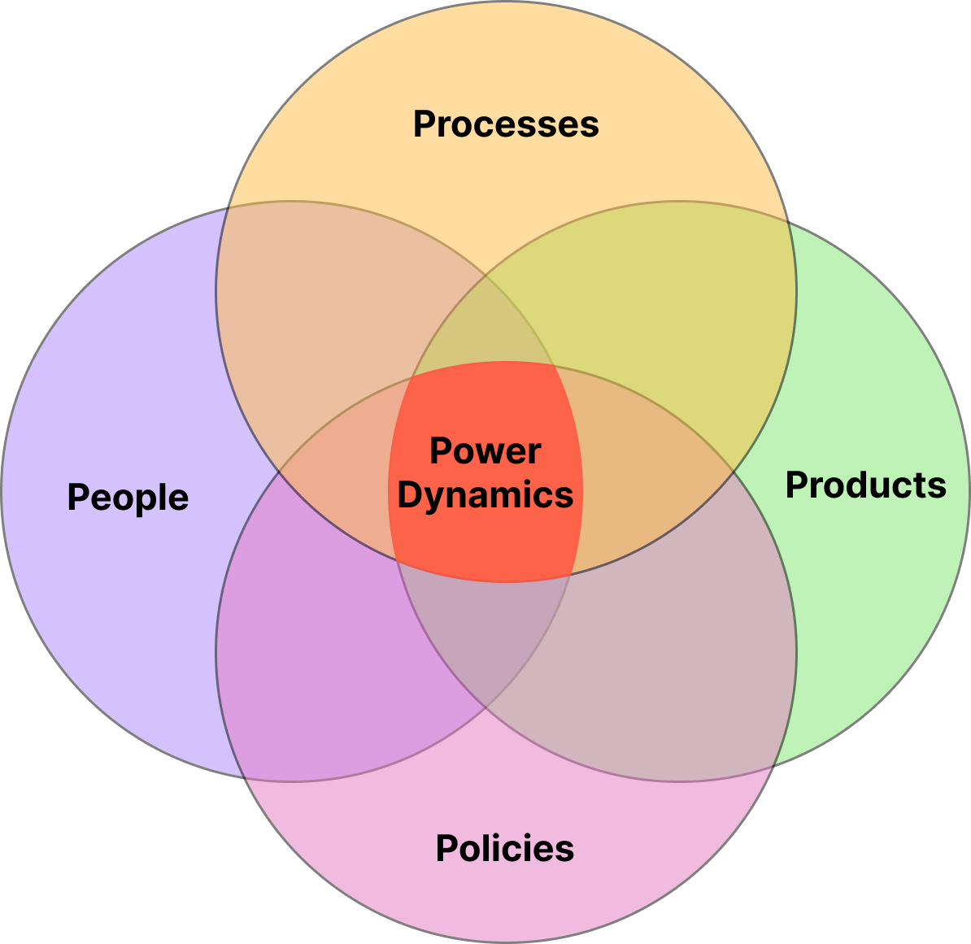
Intersectional Software Engineering (ISE)
ISE is defined as a field of study in software engineering that acquires knowledge about power dynamics in specific domains (e.g., education, industry, non-governmental organizations) and environments (e.g., classroom, workplace) using gender-forward intersectionality or intersectionality as a framework
Takaoka, Alicia Julia Wilson, Claudia Maria Cutrupi, and Letizia Jaccheri. "Intersectional Software Engineering as a Field." Software 4.3 (2025): 18. https://www.mdpi.com/2674-113X/4/3/18
Notes:
When we think how intersectionality can impact SE, we can define four power dynamics: in this paper we aimed to define ISE as a field of study.
ISE highlights the importance of recognizing and evaluating power imbalances through four fundamental dimensions
People: group dynamics, stereotypes, implicit bias
Processes: fundamental design errors, lack of user cetered participation
Products: exclusions from testing, developing
Policies: gender equity plans

Slide 50
Diversity TDT4290 Customer Driven Project
Group division based on diversity factors (gender, background, nationality)
Update compendium, modified evaluation criteria
Introducing the concept of diversity in reports
Implementing rotation system for non Agile roles
Holding a lecture about diversity
Introducing inclusive language in compendium
Conducting final survey
Observing diversity in customers and teaching staff
Studies to observe perceptions on diversity

Slide 51
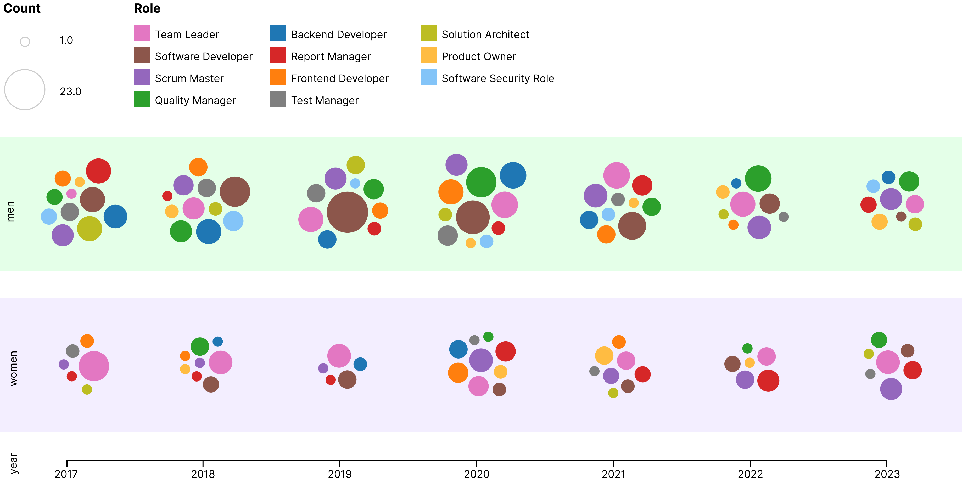
Diversity in software development teams
Cutrupi, C. M., Jaccheri, L., & Papavlasopoulou, S. (2025). Women’s Participation in Student Software Development Teams: A Cross-Sectional Study on Role Distribution. IEEE Transactions on Software Engineering. https://ieeexplore.ieee.org/abstract/document/11175036

Slide 52
What you can do in your project
The teams should reflect how diversity dimension(s) is perceived in their project, how diversity impacts the product realized, how diverse are users involved in the process.
The teams should reflect how diversity dimension(s) impact the team dynamics: what aspects of diversity you encounter, how you manage differences between members, criteria used to assign roles, how you address diversity topics during the course, self reflection on the impact of diversity.
From Compendium, paragraph 3.12, page 23

Slide 53
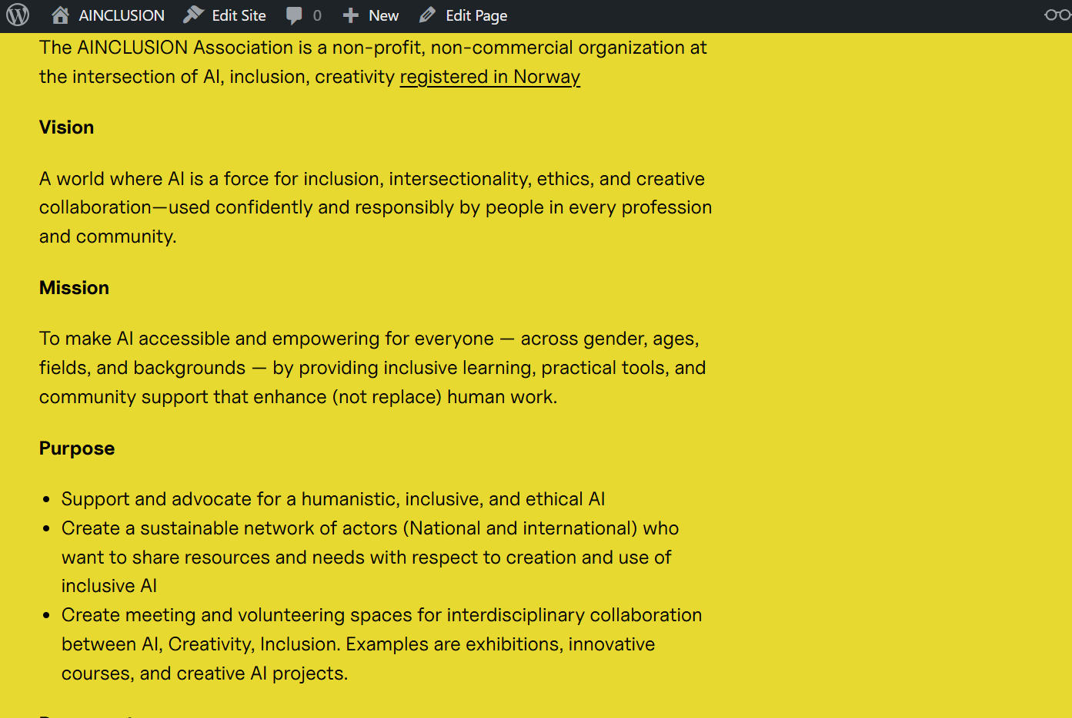
NGO AINCLUSION

Slide 54
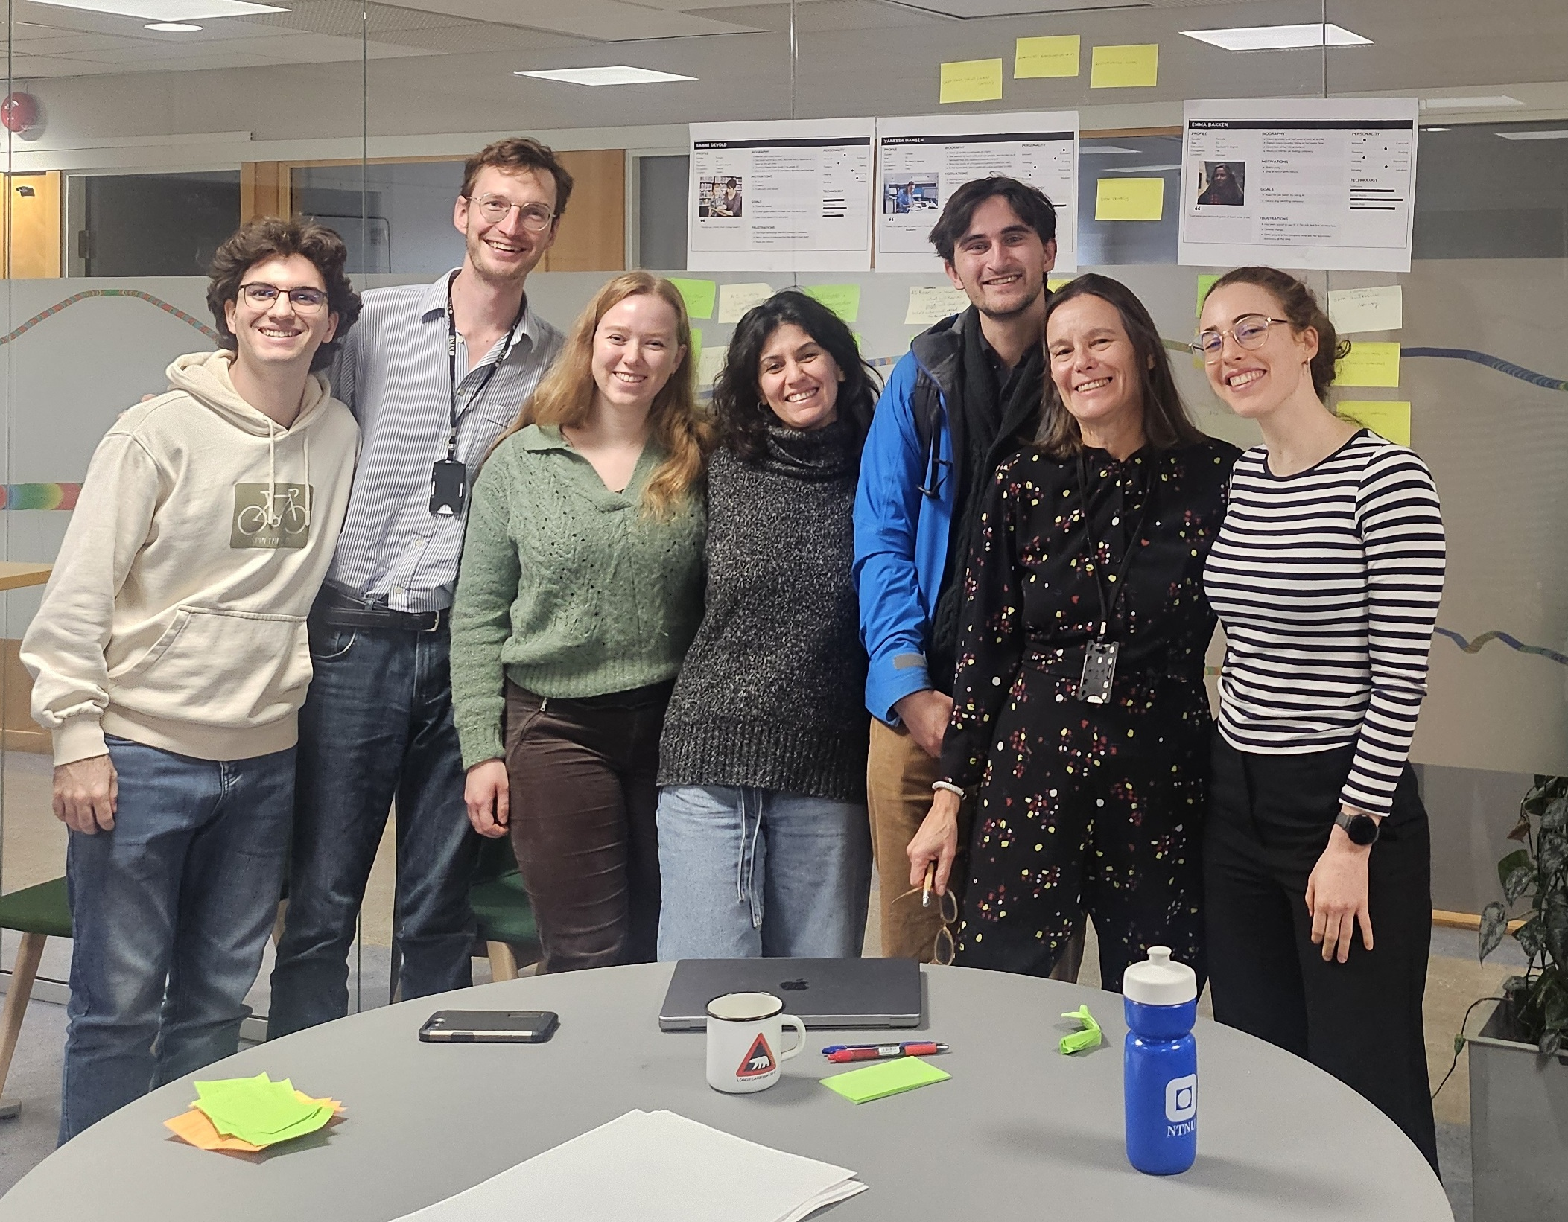
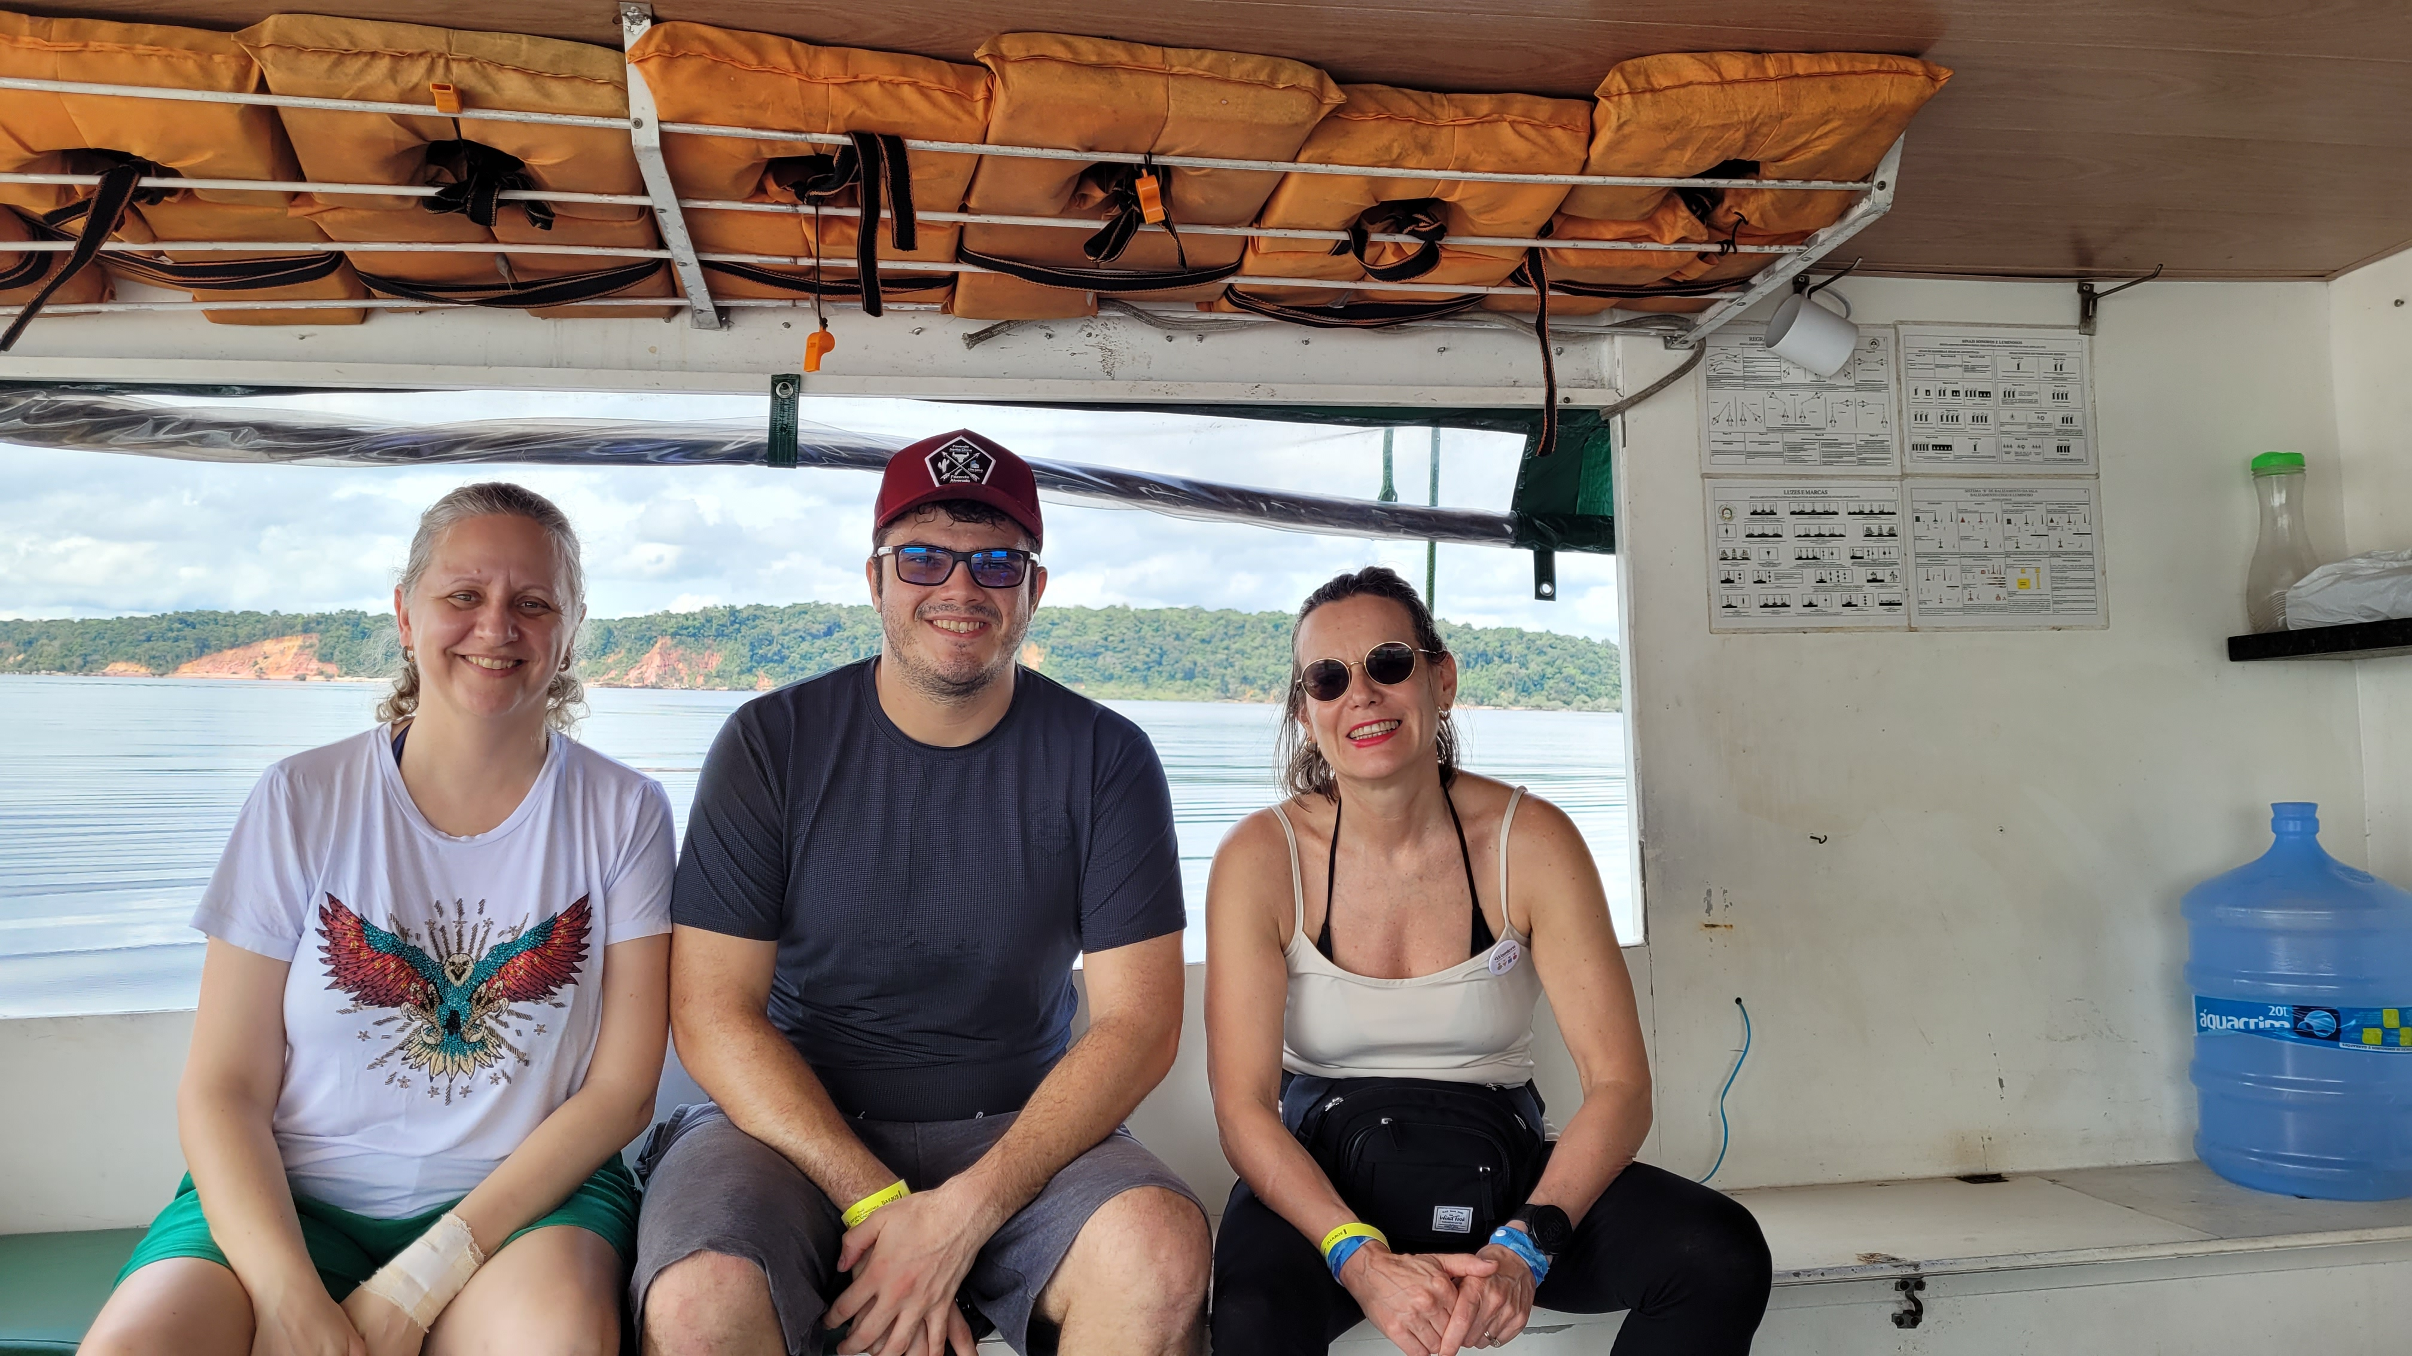
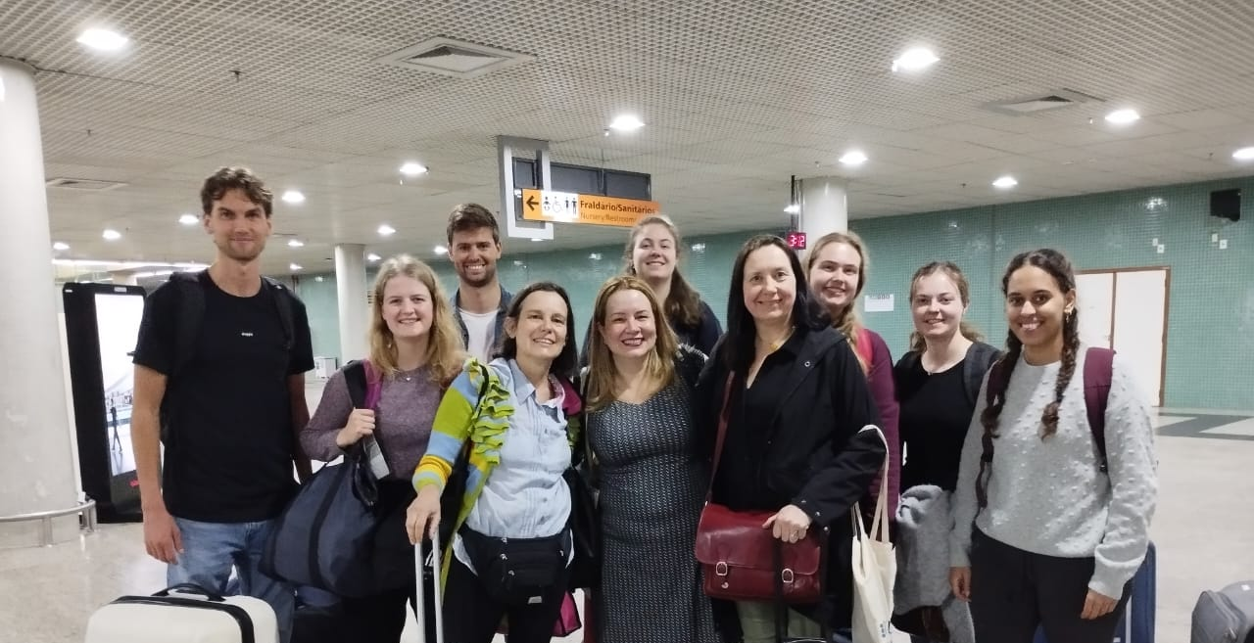
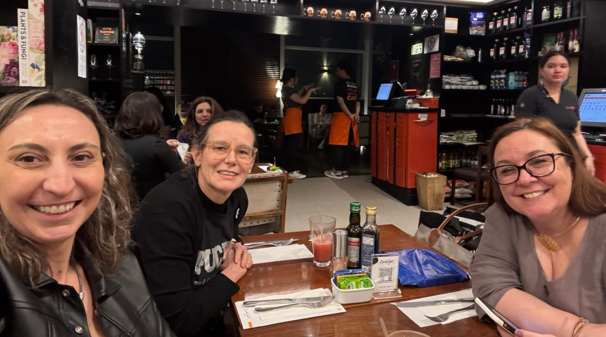

Slide 55



More References
Crenshaw, K. W. (2013). Mapping the margins: Intersectionality, identity politics, and violence against women of color. In M. A. Fineman & R. Mykitiuk (Eds.), *The public nature of private violence* (pp. 93–118). Routledge.
Hagen, M. H., Hartvigsen, G., Jaccheri, L., & Papavlasopoulou, S. (2024). Digital psychosocial follow-up for childhood critical illness survivors: A qualitative interview study on health professionals’ perspectives. *Scandinavian Journal of Child and Adolescent Psychiatry and Psychology, 12*(1), 50–62.
El Shemy, I., Jaccheri, L., Giannakos, M., & Vulchanova, M. (2024). Participatory design of augmented reality games for word learning in autistic children: The parental perspective. In *Proceedings of IFIP ICEC ’24*.
Cutrupi, C. M., Zanardi, I., & Jaccheri, L. (2024). Draw a software engineer test: Preliminary attempts to investigate university students’ perceptions of software engineering professions. In *Proceedings of the 5th ACM/IEEE Workshop on Gender Equality, Diversity, and Inclusion in Software Engineering*.
Cutrupi, C. M., Jaccheri, L., & Serebrenik, A. (2026). Gender diversity interventions in software engineering: A comprehensive review of existing practices. *Computer Science Review, 59,* 100812.
Cutrupi, C. M., Jaccheri, L., & Papavlasopoulou, S. (2025). Women’s participation in student software development teams: A cross-sectional study on role distribution. *IEEE Transactions on Software Engineering.*
Takaoka, A. J. W., Cutrupi, C. M., & Jaccheri, L. (2025). Intersectional software engineering as a field. *Software, 4*(3), 18.

